Slide 1

Insurance Premium Predictions
Predicting Truck Insurance Premiums
“A Deep Learning Approach”
Viriato Segura, William Riera, Sam Pearlman

Slide 2
Motivation And Summary
In a consumer society we have learned that our transportation infrastructure is an absolute necessity in our economy. Truckers are the backbone of our society. With more purchases being made over the internet and consumer goods trading at a historic high we wanted to evaluate the largest expense these truckers have which is their Insurance. We are attempting to develop an insurance rater which can predict premiums and ultimately make our product and the market more competitive.

Slide 3
Model Summary
We used three models to predict our Insurance Premiums. The first two models were put together using Scikit Learn and TensorFlow. Our third model used Pytorch with Linear regression. We found the model 2, our model with two hidden layers was the best choice. We also the keras algorithm with this model. This was the best model for us. We used also used a PCA to help us determine which were the most important X’s This model was able to predict our insurance premiums almost to an exact number

Slide 4
Data Cleanup and Model Training
We were able to gather the data from CAB. CAB is the Central Analysis Bureau. They are a private company which gathers and distributes data for the transportation industry. We had some challenges gathering the data because at some point we felt there was almost too much data. There are over 3 million active trucks in the United States. We also were challenged on what data to use. CAB uses over 150 different metrics to define a trucking company. For our project we were only able to use 5. When challenge that arose is that there are some very significant outliers. One of which was the number of trucks in a company. Most companies have between 5-20 trucks but here were several who had thousands. This kept throwing off our models.

Slide 5
Model Evaluation
(Mean Square Error) (Mean Absolute Percentage Error)
Model 1 MSE, MAPE
Epoch 250/250
31/31 - 0s - loss: 27749736448.0000 - mse: 27749736448.0000 - mape: 62.6667 - val_loss: 21530126336.0000 - val_mse: 21530126336.0000 - val_mape: 64.1250 - 84ms/epoch - 3ms/step
Model 2 MSE, MAPE
Epoch 250/250
31/31 - 0s - loss: 8052227.5000 - mse: 8052227.5000 - mape: 6.6598 - val_loss: 8662837.0000 - val_mse: 8662837.0000 - val_mape: 6.2967 - 96ms/epoch - 3ms/step

Slide 6
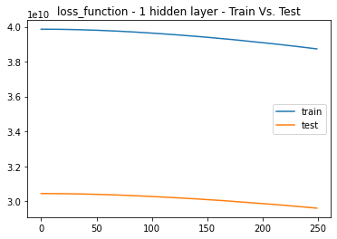
LOSS FUNCTION 1 HIDDEN LAYER
TRAINING Vs TESTING

Slide 7
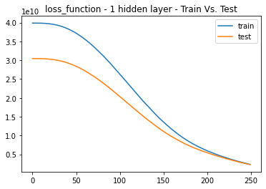
LOSS FUNCTION TRAINING Vs TESTING

Slide 8
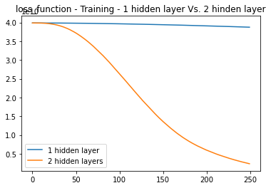
LOSS FUNCTION TRAINING

Slide 9
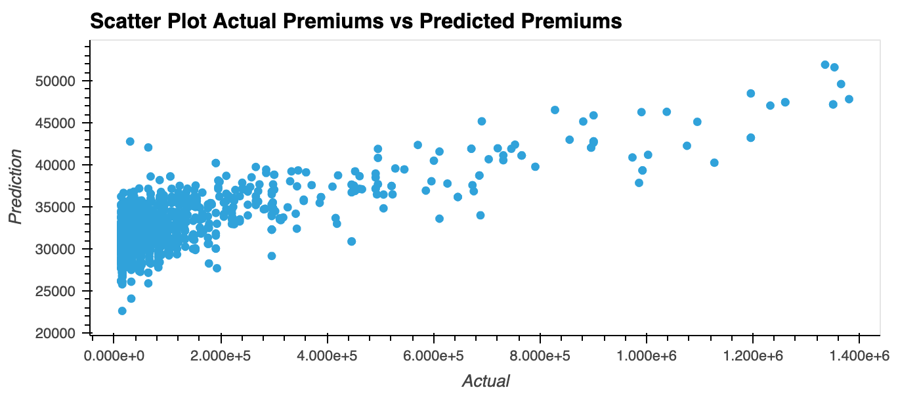

Slide 10
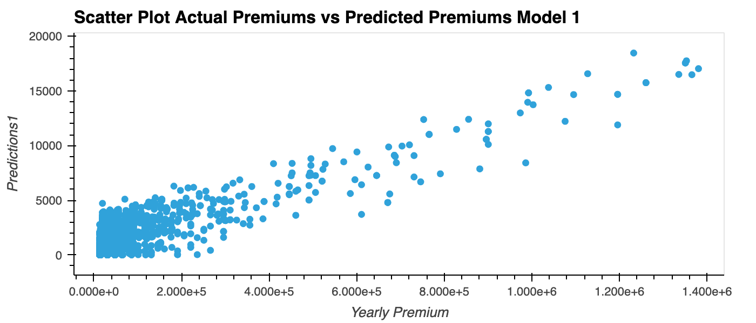

Slide 11
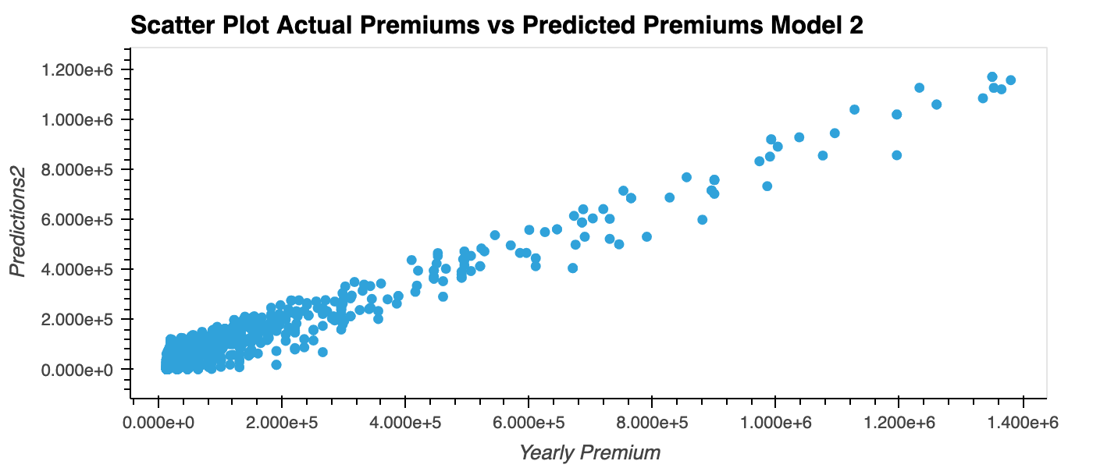

Slide 12
Discussion
We used three different models. The model with 2 hidden layers was the model which had the best predictions. We learned that there has to be a sweet spot with how many layers and epochs you use. Our first model only used 1 layer and was very inaccurate, and out third model with Pytorch used 3 different layers and was also inaccurate. On our second model which we only used 2 layers we found the best accuracy. We had to play around with the epochs and verbose in order to determine the best predictions. One limitation we had was the we only used 5 features. I believe that once we implement all 150 feature there could be a change on which model would predict best.l

Slide 13
Postmortem
One of the difficulties that arose our limited knowledge with Pytorch. Pytorch uses many different functions we have no gone over in class and didn't have time to address. We also wanted to be able to train our model with many more features. We found that some of the features seemed great to implement but the way the data was available did not correlate with the pricing precision we were trying to make. If we had two more week we would learn more about Pytorch and we would also create at least 2 additional models with more features.

Slide 14

Questions

